Slide 1
The Council’s Federal Legislative Update on COVID-19

Slide 2
Phase One – March 6th
$6.5 billion for HHS
3.4 billion for Public Health and Social Services Emergency Fund
$2.2 billion for Centers for Disease Control and Prevention
$836 million for National Institutes of Health
$61 million for the Food and Drug Administration
Waived Medicare telehealth restrictions
$1.25 billion for State Department and USAID
Includes funds for global health programs, humanitarian and health assistance, diplomatic operations, evacuation and emergency preparedness costs
Enabled Small Business Administration to provide about $7 billion in disaster loans
For the resource center visit: ciab.com/covid19

Slide 3
Phase Two – March 18th
Created emergency paid leave programs to respond to the outbreak
Private sector employers with fewer than 500 workers and government entities have to provide as many as 12 weeks of partially paid family leave under the FMLA to care for a child whose school or day care has closed
Employers to provide full- and part-time workers with two weeks paid sick time, including for a quarantine order or to care for another affected individual
Labor Department can exempt small businesses with fewer than 50 workers from the paid leave requirements
Refundable tax credits for employers to cover costs under the law’s leave programs
Includes amounts employers pay for a worker’s health insurance plan
Similar refundable credit for self-employed workers
For the resource center visit: ciab.com/covid19

Slide 4
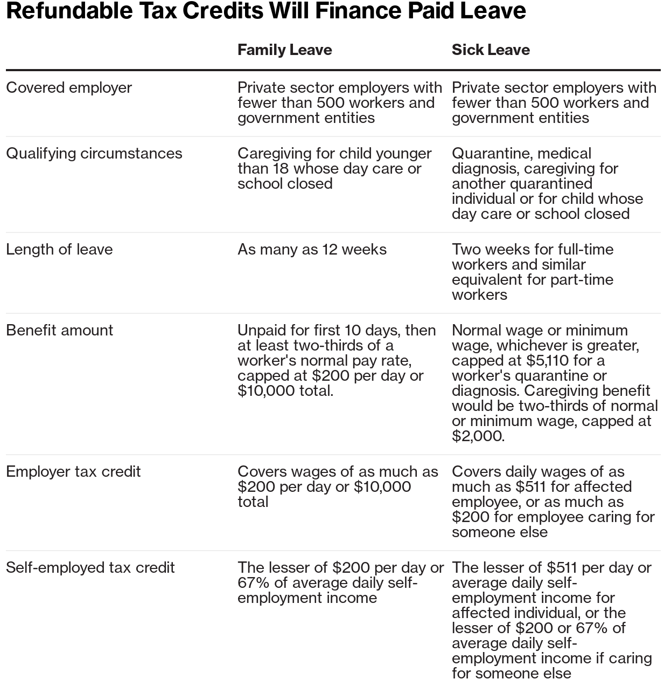
Family & Sick Leave in Phase 2

Slide 5
$2T Phase Three – S. 3548
Assembled by Senate with input from White House, deal announced at 1:45 AM today
Recovery checks of $1,200 for individuals with AGI up to $75,000 or $112,500 for those with a head of household filing. All joint filers, with AGI up to $150,000 are eligible for $2,400. Those amounts increase by $500 for every child
$600 maximum unemployment benefit per week (“ensures laid-off workers receive full pay for 4 months”)
$58 billion for airlines - prohibited from stock buybacks and CEO bonuses
$150 billion Marshall Plan for hospitals
Additional $349 billion in loans for small businesses to cover payroll and other expenses – bans stock buybacks for the term of the government assistance plus 1 year for any company receiving aid
Retention tax credit for employers to encourage businesses to keep workers on their payrolls
Waiving penalties for withdrawing as much as $100,000 from retirement plans
Technical corrections and other changes to 2017 tax overhaul
Several modifications to the emergency leave programs in the second package
Creates Treasury Department Special Inspector General for Pandemic Recovery
For the resource center visit: ciab.com/covid19

Slide 6
Phase Three: SBA Loans
Allows SBA to provide federally-backed loans from February 15, 2020 to June 30, 2020 to eligible businesses to cover operational costs, including payroll, rent, health benefits (and insurance premiums), etc.
No collateral, personal guarantees, or subsidy recoupment fees required (interest rate set at 2/15/20 level)
Eligible businesses = 500 or fewer employees
Leeway for businesses with multiple “small” locations that provide accommodation and food services
Sole proprietors, independent contractors, and self-employed individuals are eligible
Some relief from SBA affiliation rules for certain businesses
2 eligibility criteria = good-faith certification of need for the loan + agree to not fire workers
The maximum loan amount is a multiplier (2.5x) of average monthly payroll costs up to $10M cap
Businesses can use loans for almost all operating costs (with limits on individual comp above $100K, comp for non-U.S. workers, and “double dipping” for Families First paid leave wages already receiving credit)
Debt forgiveness up to the principal loan amount for certain costs incurred during the covered period
Forgivable amounts = payroll costs; interest payments on loan obligations; rent; and utilities
Forgiveness amounts reduced for firing employees or cutting wages
3/24/2020
For the resource center visit: ciab.com/covid19

